Slide 1
JPET STORE APPLICATION
Document created By: King Thomas
Version:1.0
Date :23-03-2023.

Slide 2
JMeter details
Version: Apache Jmeter5.5
Protocol: Web (HTTP/HTTPS).

Slide 3
AGENDA
Performance Testing Overview
Key objective
Key Scenarios and objective of each scenario
Approach/Success criteria
Results and Findings
Response Time Graph
Results
Key Observations

Slide 4
Key objective
The goals of performance testing include evaluating JPET STORE application output, processing speed, data transfer velocity, network bandwidth usage, maximum concurrent users, memory utilization, workload efficiency, and command response times.

Slide 5
Key Scenarios and objective of each scenario
Number of users=01
JPETSTORE Application
Module01 | Module02 | Module03
SC01_JpetStore_Customerlogin | SC02_JpetStore_ProductID | SC03_JpetStore_Paymentdetails
TR01_JpetStore_Launch | TR01_JpetStore_Launch | TR01_JpetStore_Launch
TR02_JpetStore_Login | TR02_JpetStore_Login | TR02_JpetStore_Login
TR03_JpetStore_Logout | TR03_JpetStore_ProductID | TR03_JpetStore_PaymentDetails
 | TR04_JpetStore_Logout | TR04_JpetStore_Logout

Slide 6
Approach/Success criteria
Approach
Started the dry run test with single user and single iteration
Success criteria
Able to capture the Jpet store application using web (HTTP/HTTPS) Protocol.

Slide 7
Results and Findings

Slide 8
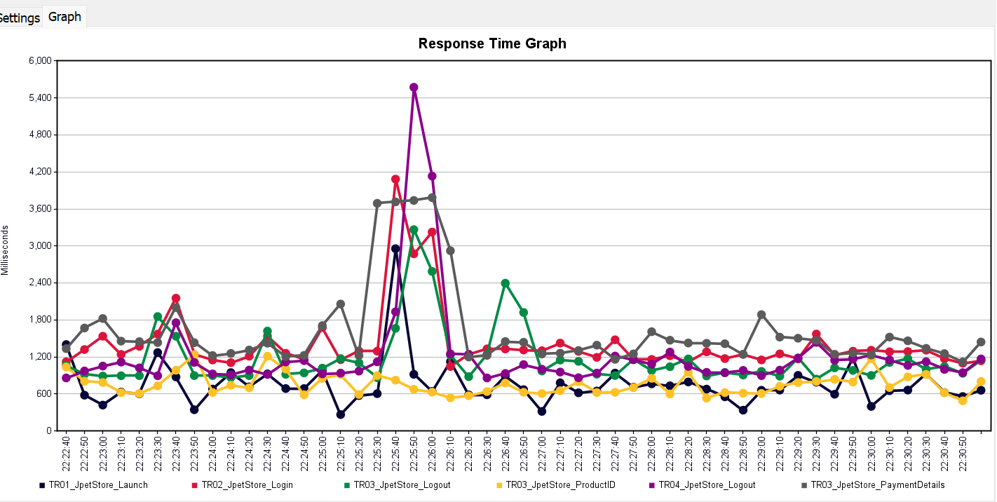
Response Time Graph

Slide 9
Results
Load Test Results with 1users 10 mins Duration on Jpetstore Application
 | Response Time in seconds
Transaction Name | Average | 90% Line | Min | Max | Passed | Failed | Throughput
TR01_JpetStore_Launch | 0.703 | 1.419 | 0.201 | 2.956 | 157 | 0.00% | 0.262
TR02_JpetStore_Login | 1.295 | 1.528 | 0.802 | 4.084 | 157 | 0.00% | 0.2622
TR03_JpetStore_ProductID | 0.722 | 0.918 | 0.473 | 1.236 | 52 | 0.00% | 0.0885
TR03_JpetStore_PaymentDetails | 1.481 | 1.824 | 1.12 | 3.784 | 52 | 0.00% | 0.0883
TR04_JpetStore_Logout | 1.076 | 1.233 | 0.814 | 3.265 | 52 | 0.00% | 0.0884

Slide 10
Key Observations
Jpet store Application is able to record with Jmeter
Jpet store Applications supports Web(HTTP/HTTPS)protocol.

